Slide 1
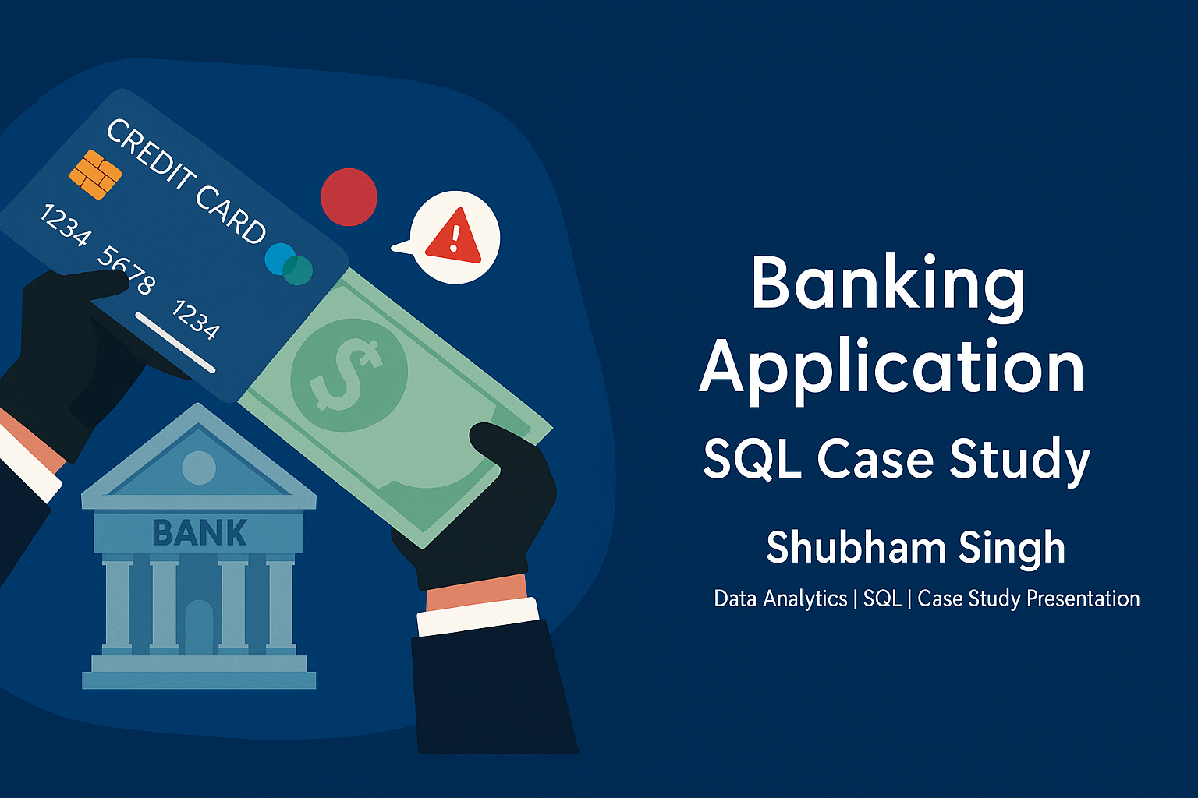

Slide 2
INTRODUCTION
This case study focuses on designing and analyzing a Simple Banking Application using SQL. The objective is to understand how a real-world banking system manages its data through structured tables and relationships. The application stores essential financial and customer-related information such as:
Customer details
Bank accounts
Transactions (deposits & withdrawals)
Branches
Account–Branch assignments
Loan information

Slide 3
OBJECTIVES OF THE CASE STUDY
This case study aims to achieve the following objectives:
Understand the structure of a banking database
Create tables with correct relationships and constraints
Populate the database with meaningful sample data
Write SQL queries to extract, filter, transform, and analyze data
Perform joins and aggregations for deeper insights
Work with subqueries and conditional logic
Practice real industry-style SQL problem solving

Slide 4
SYSTEM OVERVIEW
The Simple Banking Application consists of six major components:
Customers – stores personal information
Accounts – maintains account type & balance details
Transactions – logs deposits and withdrawals
Branches – represents the bank’s physical locations
Account Branches – maps accounts to branches
Loans – tracks loan details for each customer
These entities work together to create a functional relational banking system.

Slide 5
DATABASE SCHEMA OVERVIEW
The banking system is designed using a relational database model. It includes six interconnected tables that manage customer information, accounts, transactions, branches, account–branch mappings, and loans.
Key Tables:
Customers: Stores personal and contact details.
Accounts: Contains account type and balance information.
Transactions: Logs deposits and withdrawals for each account.
Branches: Represents different bank locations.
Account Branches: Links accounts to the branch where they are managed.
Loans: Stores loan data such as amount, interest rate, and duration.

Slide 6
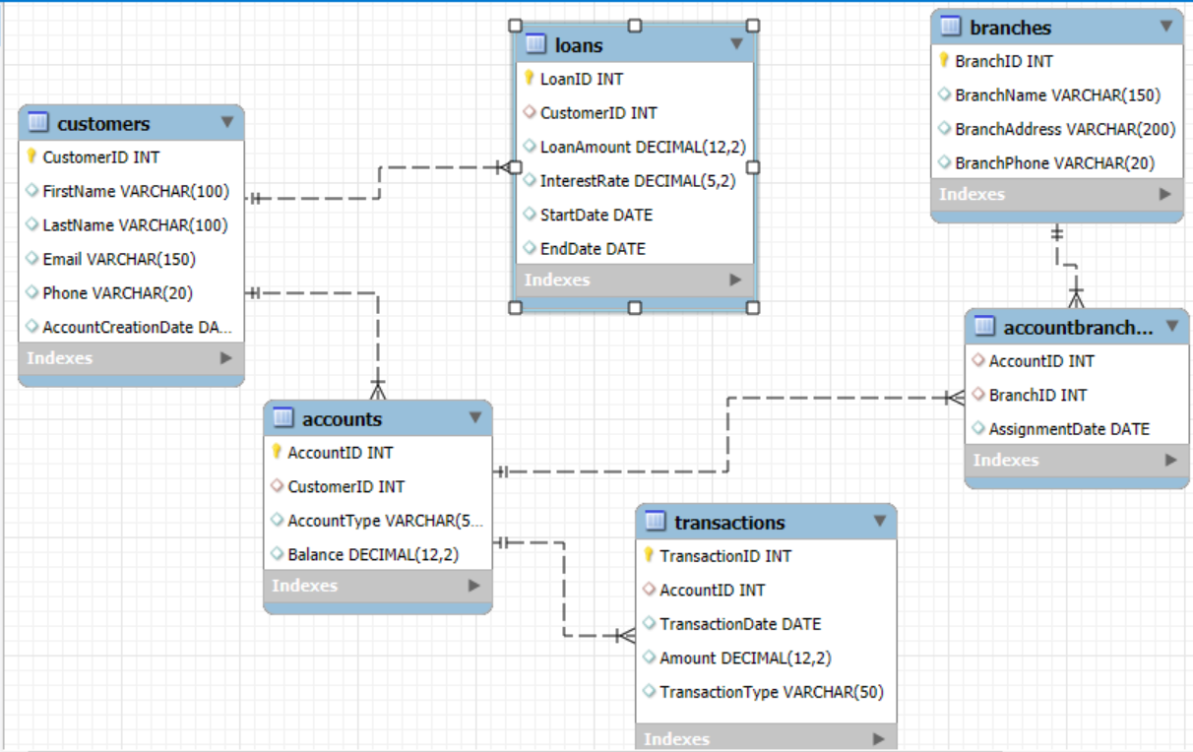
ER DIAGRAM

Slide 7
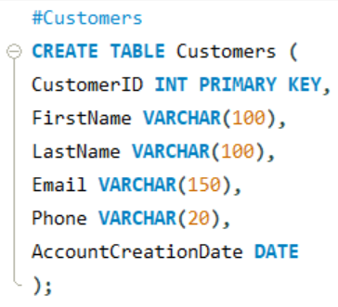
CUSTOMERS TABLE
The Customers table stores basic personal and contact information for all customers.
Attributes:
CustomerID (Primary Key)
FirstName
LastName
Email
Phone
AccountCreationDate
Purpose: Used to identify customers and maintain their basic details for account and loan management.

Slide 8
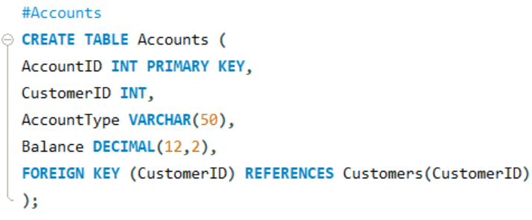
ACCOUNTS TABLE
The Accounts table maintains information about all bank accounts belonging to customers.
Attributes:
AccountID (Primary Key)
CustomerID (Foreign Key → Customers.CustomerID)
AccountType (Checking/Savings)
Balance
Purpose: Stores balance and account-type information for executing financial queries and linking with transactions.

Slide 9
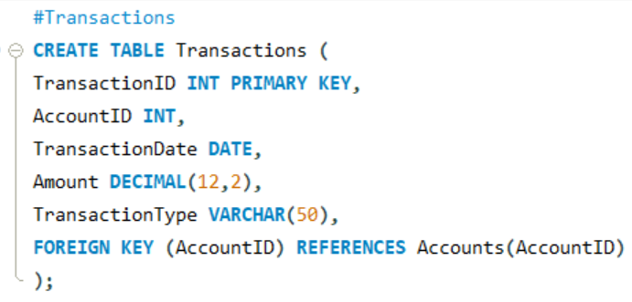
TRANSACTIONS TABLE
The Transactions table stores all actions performed on accounts, such as deposits and withdrawals.
Attributes:
TransactionID (Primary Key)
AccountID (Foreign Key → Accounts.AccountID)
TransactionDate
Amount
TransactionType (Deposit/Withdrawal)
Purpose: Helps track account activities and analyze customer spending or deposit patterns.

Slide 10
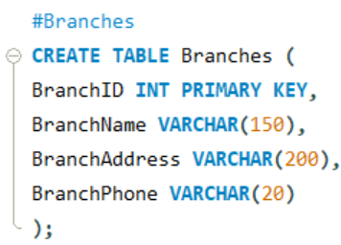
BRANCHES TABLE
The Branches table stores information about the physical branches of the bank.
Attributes:
BranchID (Primary Key)
BranchName
BranchAddress
BranchPhone
Purpose: Represents the bank’s physical presence and serves as a reference point for mapping accounts.

Slide 11
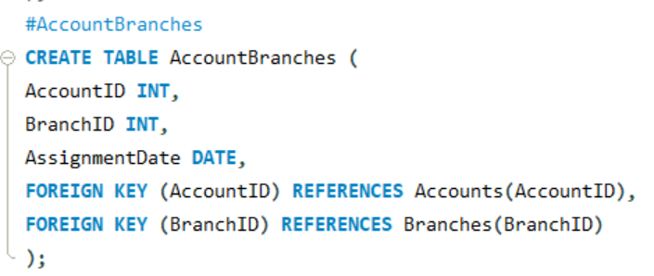
ACCOUNTBRANCHES TABLE
The AccountBranches table links each account to a specific bank branch.
Attributes:
AccountID (Foreign Key → Accounts.AccountID)
BranchID (Foreign Key → Branches.BranchID)
AssignmentDate
Purpose: Defines where each account is maintained and supports branch-level account analytics.

Slide 12
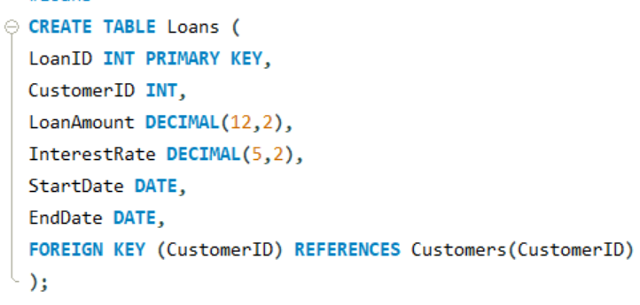
LOANS TABLE
The Loans table manages the loan details of customers.
Attributes:
LoanID (Primary Key)
CustomerID (Foreign Key → Customers.CustomerID)
LoanAmount
InterestRate
StartDate
EndDate
Purpose: Used for loan analysis, financial calculations, and finding customers with significant liabilities.

Slide 13
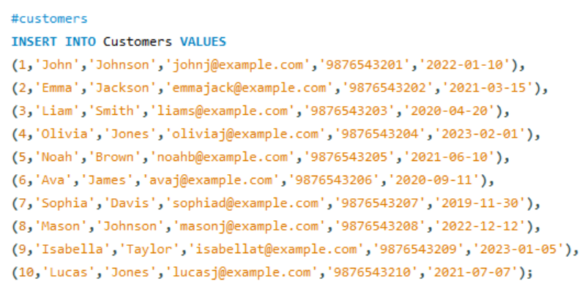
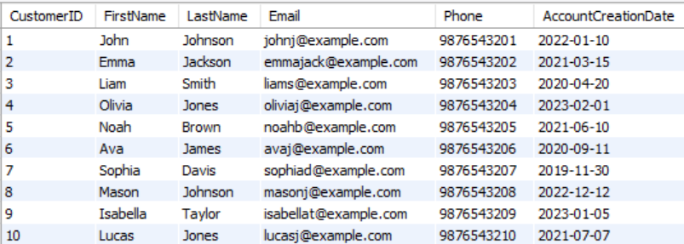
Inserting Data – Customers Table
QUERY
TABLE

Slide 14
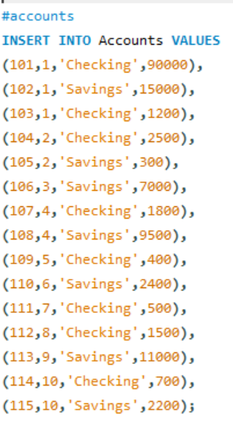
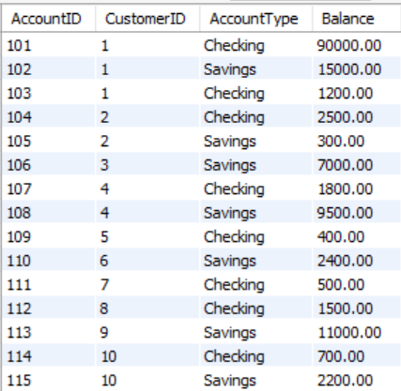
Inserting Data – Accounts Table
QUERY
TABLE

Slide 15
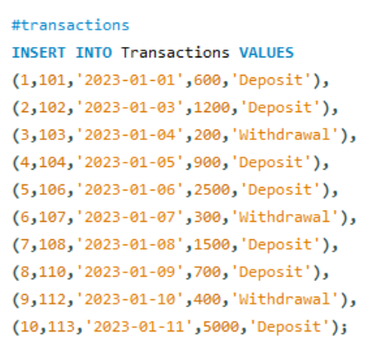
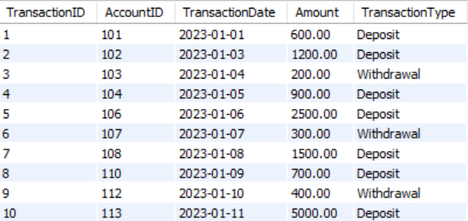
Inserting Data - Transactions Table
QUERY
TABLE

Slide 16
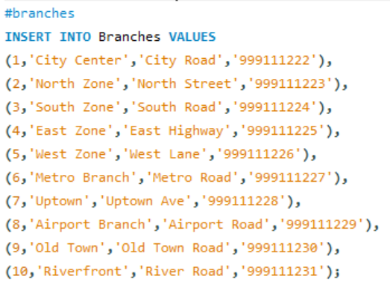
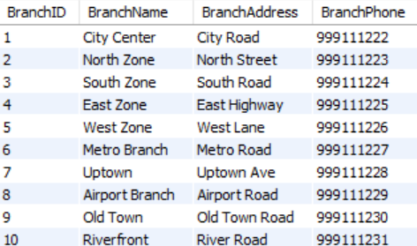
Inserting Data – Branches Table
QUERY
TABLE

Slide 17
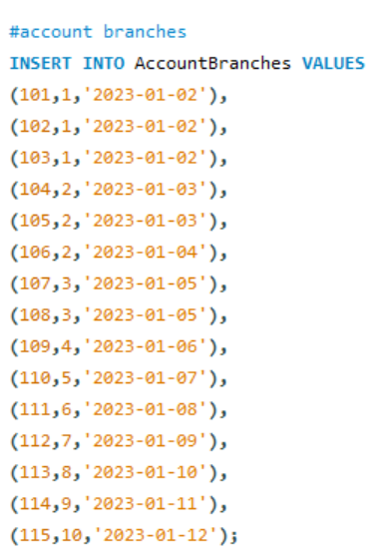
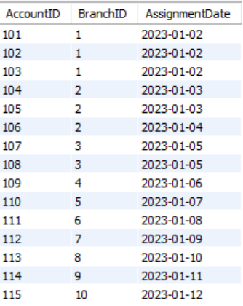
Inserting Data – Account Branches Table
QUERY
TABLE

Slide 18
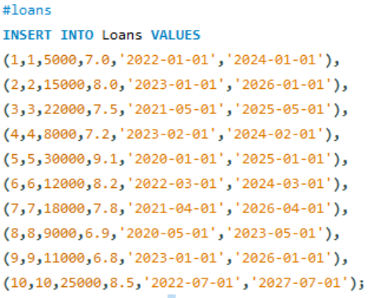
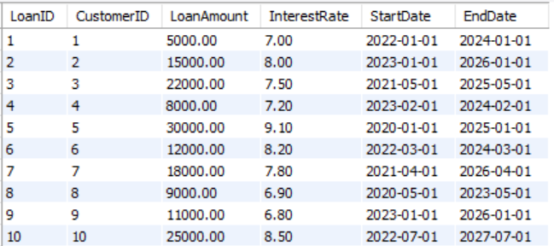
Inserting Data – Loans Table
QUERY
TABLE

Slide 19
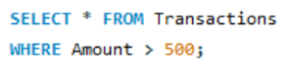
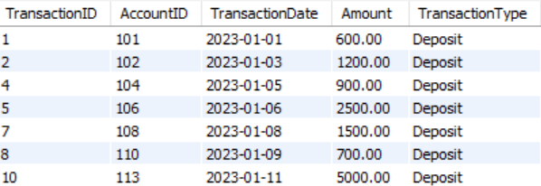
Q)Select transactions amount > $500
QUERY
TABLE

Slide 20
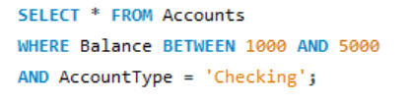
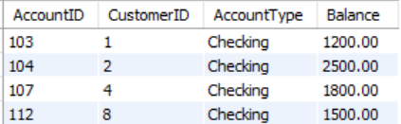
Q)Accounts with Balance between 1000 and 5000 AND type Checking
QUERY
TABLE

Slide 21
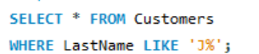
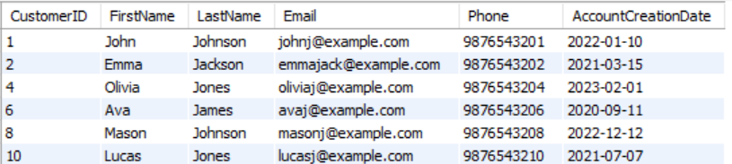
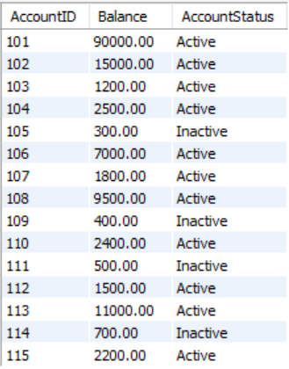
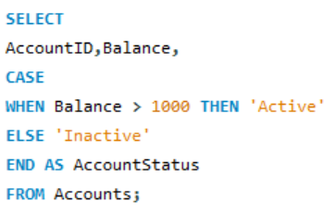
Q)Customers whose LastName starts with 'J'
QUERY
TABLE
Q)Write a query to select AccountID and a new column AccountStatus from the Accounts table. If Balance is greater than $1000, set AccountStatus to 'Active', otherwise 'Inactive'.
QUERY
TABLE

Slide 22
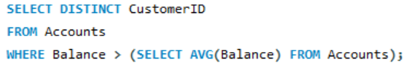
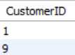
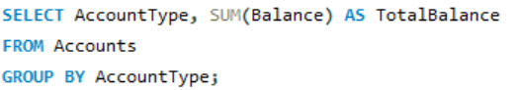
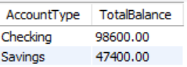
Q) Customers with balance > average balance
QUERY
TABLE
Q) Total balance per AccountType
QUERY
TABLE

Slide 23
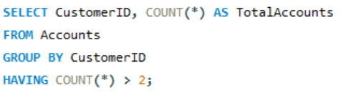
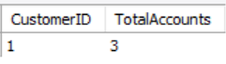
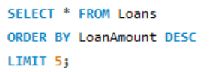
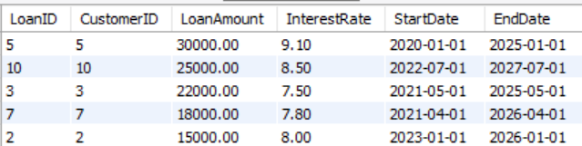
Q) Customers with more than 2 accounts
QUERY
TABLE
Q) Top 5 highest loan amounts
QUERY
TABLE

Slide 24
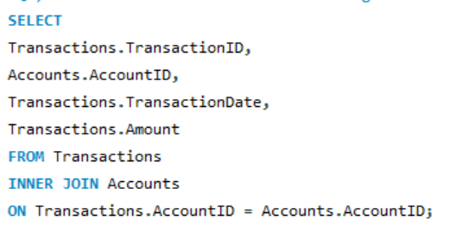
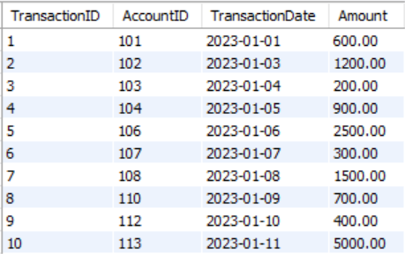
Q) Join Transactions with Accounts to get a list of all transactions.
QUERY
TABLE

Slide 25
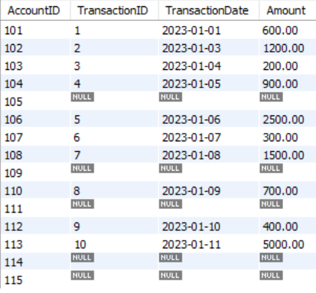
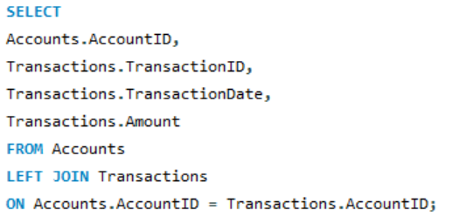
Q) list of all Accounts and any associated Transactions. Include accounts that might not have any transactions.
TABLE
QUERY

Slide 26
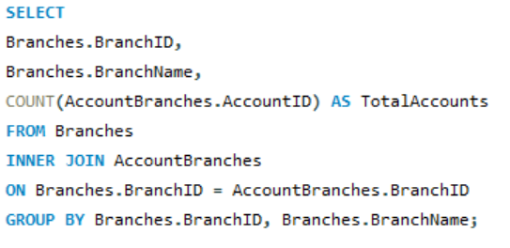
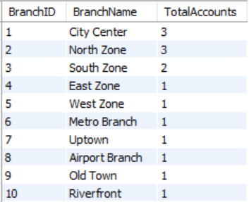
Q) The total number of accounts for each branch. Use an INNER JOIN between AccountBranches and Branches, and group by BranchID.
QUERY
TABLE

Slide 27
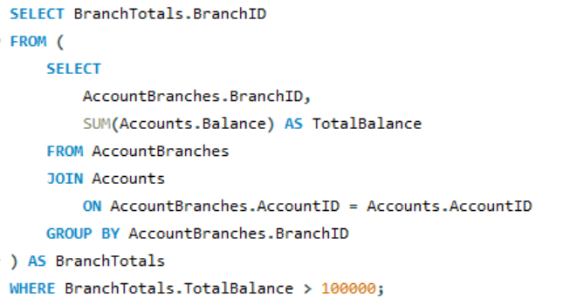
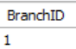
Q) Find all Branches that manage accounts with a total balance of more than $100,000. Use a subquery in the WHERE clause to find these BranchIDs.
QUERY
TABLE

Slide 28
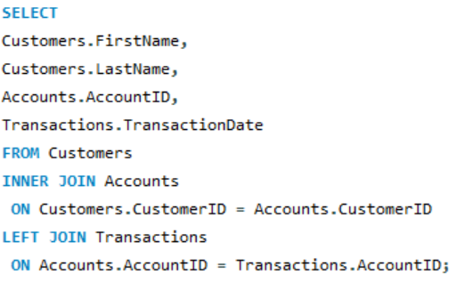
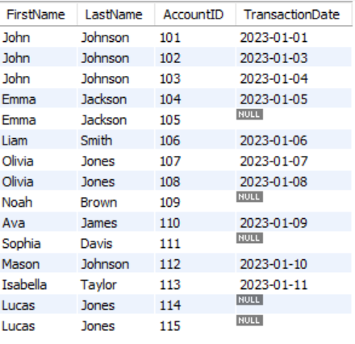
Q) List FirstName, LastName, AccountID, and TransactionDate for all transactions.Use INNER JOIN and LEFT JOIN as necessary to get all required details.
QUERY
TABLE

